Slide 1
DB Schema Design & Rest API
AA Services
CCT Services
SRV Services

Slide 2
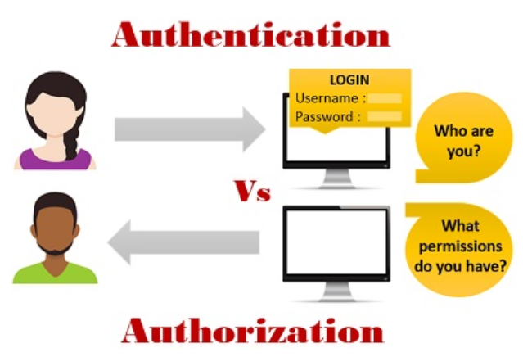
AA Services

Slide 3
DB SCHEMA
User
Role
Role Permission Mapping
Permission
Id
Name
UserName
Password
RoleId
1
1
1
*
Id
RoleId
PermissionId
Id
RoleName
Id
Operation

Slide 4
Sequence of Steps
During Start-up
Read permission from permission.properties file
Populate Role table and RolePerMapping table
Register User
User provide id, name, username, password, role.
{
"id": 2,
"name": "rohit",
"userName": "root_user",
"password": "root",
"role_id": "ADMIN"
}

Slide 5
Sequence of Steps (Contd.)
Validate User
User provide username and password which validated across DB.
If Login Unsuccessful, Proper error message is shown to the user.
After successful Login, Dashboard screen is presented on the user on the basis of permission assigned on the role of the User.
Dashboard
The dashboard will contain the menu items only on the basis of the permission assigned to the user role

Slide 6
Rest API User
S. No. | Request URL | Request/Response
1 | Create User (POST) http://localhost:8082/user
2 | Get All User (GET) http://localhost:8082/users
3 | Get User By Id (GET) http://localhost:8082/user/3
4 | Delete User (DELETE) http://localhost:8082/user/4
5 | Update User By Id (PUT) http://localhost:8082/user/2

Slide 7
Rest API Permission
S. No. | Request URL | Request/Response
6 | Get Permissions (GET): By User Id http://localhost:8082/perm/1 By User Name http://localhost:8082/permByUserName/root_user
7 | Validate Login success(GET) http://localhost:8082/validateLogin/{userName}/{password} | Boolean : true or false

Slide 8

CCT Services

Slide 9
DB Schema : Question bank
SubjectiveQ
Parameter Table
Questions
ObjectiveQ
Id(ID of Q Table)
Statement
Options
Correct Answer
Id
Q ID
Name
Type
TestcaseId
ID
Language
Type
Experience
createdUserId
*
Output Table
1
Id(ID of Q Table)
Statement
MethodName
TestcaseId
Output

Slide 10
Rest API Question :
S. No. | Request URL | Request/Response
1 | Create Questioner (POST) http://localhost:8082/question
2 | Get All Questions (GET) http://localhost:8082/questions
3 | Get Question By Id (GET) http://localhost:8082/question/1
4 | Delete User (DELETE) http://localhost:8082/question/1
5 | Update Question By Id (PUT) http://localhost:8082/question/1

Slide 11

SRV Services

Slide 12
Take Challenge
Subjective Result Table
Scheduled Table
Objective Result Table
Q. Id
Assigned User Id
Assigner User Id
User Id
Q. Id
Selection Option
AssignedUser Id
Q. Id
Program blob
Consolidated O/P

Slide 13


